Slide 1


21AIE211 Introduction to COMPUTER NETWORKS
2-0-3-3

Slide 2
APPLICATION LAYER
Learn about protocols by examining popular application-level protocols
HTTP
User-Server Interaction: Cookies
WebCaching ( Proxy Servers)
FTP
SMTP / POP3 / IMAP

Slide 3
User-Server Interaction: Cookies
We mentioned above that an HTTP server is stateless. This simplifies server design and has permitted engineers to develop high-performance Web servers that can handle thousands of simultaneous TCP connections. However, it is often desirable for a Web site to identify users, either because the server wishes to restrict user access or because it wants to serve content as a function of the user identity. For these purposes, HTTP uses cookies. Cookies, defined in [RFC 6265], allow sites to keep track of users. Most major commercial Web sites use cookies today

Slide 4
User-server state: cookies
many Web sites use cookies
four components:
cookie header line of HTTP response message
cookie header line in next HTTP request message
cookie file kept on user’s host, managed by user’s browser
back-end database at Web site
example:
Susan always access Internet
from PC
visits specific e-commerce site for first time
when initial HTTP requests arrives at site, site creates:
unique ID
entry in backend database
for ID
Application Layer
2-4

Slide 5





Cookies: keeping “state” (cont.)
client
server
ebay 8734
usual http request msg
Amazon server creates ID 1678 for user
cookie file
usual http response
set-cookie: 1678
create
backend
ebay 8734
amazon 1678
entry database
usual http request msg
cookie: 1678
cookie- specific action
access
usual http response msg
one week later:
access
ebay 8734
amazon 1678
usual http request msg
cookie: 1678
cookie- specific action
usual http response msg
Application Layer
2-5

Slide 6
Cookies (continued)
cookies and privacy:
cookies permit sites to learn a lot about you
Using a combination of cookies and user-supplied account information, a
Web site can learn a lot about a user and potentially sell this information to a third party.- cookies controversy
what cookies can be used for:
authorization
shopping carts
recommendations
user session state (Web e-mail)
“one-click shopping”—
how to keep “state”:
protocol endpoints: maintain state at sender/receiver over multiple transactions
cookies: http messages carry state
Cookies can thus be used to create a user session layer on top of stateless HTTP. For example, when a user logs in to a Web-based e-mail application (such as Hotmail), the browser sends cookie information to the server, permitting the server to identify the user throughout the user’s session
with the application.
name
As in previous slide, in that manner, the Amazon server is able to track Susan’s activity at the Amazon site. Although the Amazon Web site does not necessarily know Susan’s name, it knows exactly which pages user 1678 visited, in which order, and at what times!
2-6

Slide 7
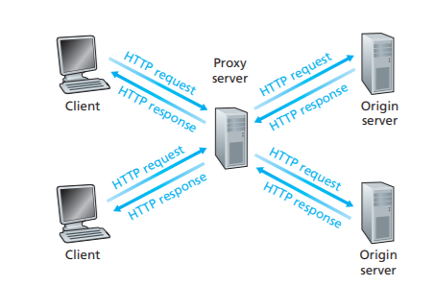
Web caches (proxy server)
A Web cache—also called a proxy server—is a network entity that satisfies HTTP requests on the behalf of an origin Web server. The Web cache has its own disk storage and keeps copies of recently requested objects in this storage
user sets browser: Web accesses via cache
browser sends all HTTP requests to cache
object in cache: cache returns object
else cache requests object from origin server, then returns object to client
goal: satisfy client request without involving origin server
Application Layer
2-7

Slide 8
What happens when a browser requests an object?
As an example, suppose a browser is requesting the
object http://www.someschool.edu/campus.gif. Here is what happens
The browser establishes a TCP connection to the Web cache and sends an HTTP request for the object to the Web cache.
The Web cache checks to see if it has a copy of the object stored locally. If it does, the Web cache returns the object within an HTTP response message to the client browser.
If the Web cache does not have the object, the Web cache opens a TCP connection to the origin server, that is, to www.someschool.edu.
The Web cache then sends an HTTP request for the object into the cache-to-server TCP connection.
After receiving this request, the origin server sends the object within an HTTP response to the Web cache.
When the Web cache receives the object, it stores a copy in its local storage and sends a copy, within an HTTP response message, to the client browser (over the existing TCP connection between the client browser and the Web cache).

Slide 9
More about Web caching
why Web caching?
cache acts as both client and server
server for original requesting client
client to origin server
typically cache is installed by ISP (university, company, residential ISP)
reduce response time for client
request
reduce traffic on an institution’s
access link- not to upgrade
bandwidth
Web caches can substantially
reduce Web traffic in the Internet
as a whole, thereby improving
performance for all applications.
Internet dense with caches:
enables “poor” content providers
to effectively deliver content (so
too does P2P file sharing)
Application Layer
2-9

Slide 10
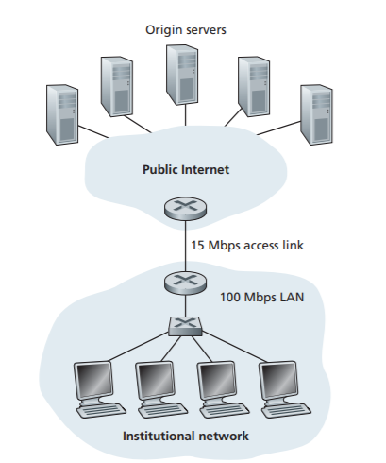
Caching example:
assumptions:
avg object size: 1 Mbits
avg request rate from browsers to origin servers:15 requests/sec
avg data rate to browsers: 1.50 Mbps
“Internet delay.”:two seconds on average
The total response time—that is, the time from the browser’s request of an object until its receipt of the object—is the sum of the LAN delay, the access delay ,and the Internet delay
The traffic intensity on the LAN s = 0.15
whereas the traffic intensity on the access link (from the Internet router to institution
router) is = 1
As the traffic intensity approaches 1 , the delay on a
link becomes very large and grows without bound
average response time to satisfy requests is going to be on the
order of minutes, if not more
Application Layer

Slide 11
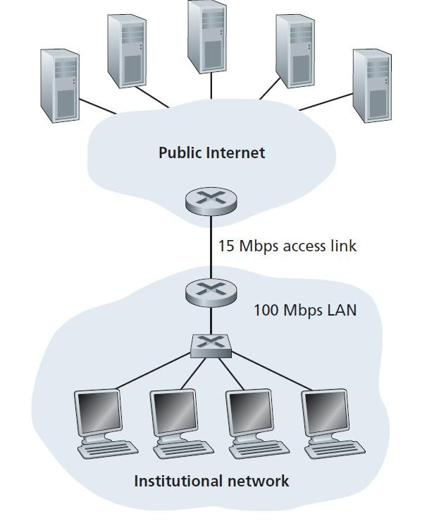


Caching example: faster access link
One possible solution is to increase the access rate from 15 Mbps to, say, 100 Mbps. This will lower the traffic intensity on the access link to 0.15, which translates to negligible delays between the two routers. In this case, the total response
time will roughly be two seconds, that is, the Internet delay. But this solution also means that the institution must upgrade its access link from 15 Mbps to 100 Mbps, a costly proposition.
origin
servers
1.54 Mbps access link
100Mbps
Cost: increased access link speed (not cheap!)
Application Layer

Slide 12
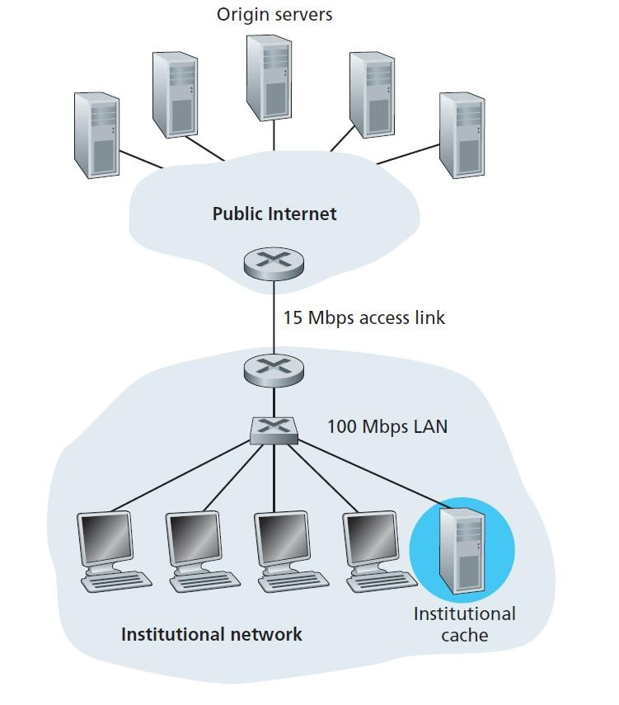
Caching example: install local cache
Now consider the alternative solution of not upgrading the access link but instead installing a Web cache in the institutional network
let’s
suppose that the cache provides a hit rate of 0.4 for this institution.
40 percent of the requests will be satisfied almost immediately, say, within 10 milliseconds, by the cache. Nevertheless, the remaining 60 percent of the requests still need to be satisfied by the origin servers. But with only 60 percent of the requested objects passing through the access link, the traffic intensity on the access link is reduced from 1.0 to 0.6.
Average Delay is just slightly greater than 1.2 seconds
Cost: web cache (cheap!)
Application Layer

Slide 13




Conditional GET
Goal: don’t send object if cache has up-to-date cached version
no object transmission delay
lower link utilization
cache: specify date of cached
copy in HTTP request
If-modified-since: <date>
server: response contains no object if cached copy is up-to- date:
HTTP/1.0 304 Not Modified
client
server
HTTP request msg
If-modified-since: <date>
object not modified before
<date>
HTTP response
HTTP/1.0
304 Not Modified
HTTP request msg
If-modified-since: <date>
object modified after
<date>
HTTP response
HTTP/1.0 200 OK
<data>
Application Layer

Slide 14


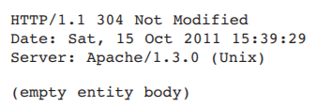
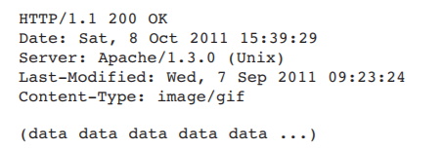
Conditional GET
One week later, another browser requests the same object via the cache, and the object is still in the cache
On the behalf of a requesting browser, a proxy cache sends a
request message to a Web server
The Web server sends a response message to the cache:
The Web server sends a response message with the requested object to the cache:

Slide 15
APPLICATION LAYER
File Transfer Protocol : FTP

Slide 16
File Transfer Protocol: FTP
In a typical FTP session, the user is sitting in front of one host (the local host) and wants to transfer files to or from a remote host. In order for the user to access the remote account, the user must provide a user identification and a password. After providing this authorization information, the user can transfer files from the local file system to the remote file system and vice versa
The user interacts with FTP through an FTP user agent.
The user first provides the hostname of the remote host, causing the FTP client process in the local host to establish a TCP connection with the FTP server process in the remote host.
The user then provides the user identification and password, which are sent over the TCP connection
as part of FTP commands.
Once the server has authorized the user, the user copies one or more files stored in the local file system into the remote file system (or vice versa).

Slide 17








FTP: the file transfer protocol
FTP
user interface
FTP
client
file transfer
FTP
server
user at host
remote file
system
local file system
transfer file to/from remote host
client/server model
client: side that initiates transfer (either to/from remote)
server: remote host
ftp: RFC 959
ftp server: port 21
Application Layer
2-17

Slide 18
FTP: separate control, data connections
The most striking difference of FTP and HTTP is that FTP uses two parallel TCP connections to transfer a file, a control connection and a data connection.
The control connection is used for sending control information between the two hosts—information such as
user identification, password, commands to change remote directory, and commands to “put” and “get” files
The data connection is used to actually send a file.
FTP client contacts FTP server at port 21, using TCP
client authorized over control connection
client browses remote directory, sends commands over control connection
when server receives file transfer command, server opens 2nd TCP data connection (for file) to client
after transferring one file, server closes data connection
2-18

Slide 19



FTP: separate control, data connections
server opens another TCP data connection to transfer another file- data connection – non persistent
control connection: “out of band”
Throughout a session, the FTP server must maintain state about the user .The server must associate the control connection with a specific user account, and the server must keep track of the user’s current directory as the user wanders about the remote directory tree.
Keeping track of this state information for each ongoing user session significantly constrains the total number of sessions that FTP can maintain simultaneously
TCP control connection, server port 21
TCP data connection, server port 20
FTP
client
FTP
server

Slide 20
FTP commands, responses
sample commands:
sent as ASCII text over control channel
USER username
PASS password
LIST return list of file in current directory
RETR filename retrieves (gets) file
STOR filename stores (puts) file onto remote host
sample return codes
status code and phrase (as in HTTP)
331 Username OK, password required
125 data connection already open; transfer starting
425 Can’t open data connection
452 Error writing file
The commands, from client to server, and replies, from server to client, are sent across the control connection in 7-bit ASCII format
Each command consists of four uppercase ASCII characters, some with
optional arguments
Application Layer
2-20

Slide 21
APPLICATION LAYER
Electronic Mail in the Internet
SMTP (Simple Mail Transfer Protocol)
POP3
IMAP
Reference: Chapter2, J. Kurose and K. Ross 2012,
Computer Network,6th ed.

Slide 22
Electronic Mail in the Internet
Electronic mail has been around since the beginning of the Internet. It was the most popular application when the Internet was in its infancy, and has become more and more elaborate and powerful over the years. It remains one of the Internet’s most important and utilized applications
e-mail is an asynchronous communication medium—people send and read messages when it is convenient for them, without having to coordinate with other people’s schedules
In contrast with postal mail, electronic mail is fast, easy to distribute, and inexpensive
Modern e-mail has many powerful features, including messages with attachments, hyperlinks,
HTML-formatted text, and embedded photos

Slide 23

Electronic mail
user
agent
Three major components:
user agents
mail servers
simple mail transfer protocol: SMTP
User Agent
a.k.a. “mail reader”
composing, editing, reading mail messages
e.g., Outlook, iPhone mail client
outgoing, incoming messages stored on server
mail
server
user
agent
SMTP
mail
server
user
agent
SMTP
SMTP
user
agent
mail
server
user
agent
user
agent
outgoing
message queue
user mailbox
Application Layer: 2-23

Slide 24












Electronic mail: mail servers
Mail servers:
mailbox contains incoming messages for user
message queue of outgoing (to be sent) mail messages
SMTP protocol between mail servers to send email messages
client: sending mail server
“server”: receiving mail server
A typical message starts its journey in the sender’s user agent, travels to the sender’s mail server, and travels to the recipient’s mail server, where it is deposited in the recipient’s mailbox
user agent
mail server
user
agent
SMTP
mail
user agent
server
SMTP
SMTP
user agent
mail
server
user
agent
user agent
Application Layer

Slide 25
Electronic Mail: SMTP [RFC 2821]
uses TCP to reliably transfer email message from client to server, port 25
direct transfer: sending server to receiving server
three phases of transfer
handshaking (greeting)
transfer of messages
closure
command/response interaction (like HTTP)
commands: ASCII text
response: status code and phrase
messages must be in 7-bit ASCII
SMTP restricts the body (not just the headers) of all mail messages to simple 7-bit ASCII.But today, in the multimedia era, the
7-bit ASCII restriction is a bit of a pain—it requires binary multimedia data to be encoded to ASCII before being sent over SMTP; and it requires the corresponding ASCII message to be decoded back to binary after SMTP transport
HTTP does not require multimedia data to be
ASCII encoded before transfer.
Application Layer

Slide 26








Scenario: Alice sends message to Bob
We now describe each of the components in the context of a sender, Alice, sending an e-mail message to a recipient, Bob. User agents allow users to read, reply to, forward, save, and compose messages. Microsoft Outlook and Apple Mail are examples of user agents for e-mail. When Alice is finished composing her message, her user agent sends the message to her mail server, where the message is placed in the mail server’s outgoing message queue. When Bob wants to read a message, his user agent retrieves the message from his mailbox in his mail server.
When Bob wants to access the messages in his mailbox, the mail server containing his mailbox
authenticates Bob (with usernames and passwords). Alice’s mail server must also deal with failures in Bob’s mail server. If Alice’s server cannot deliver mail to Bob’s server, Alice’s server holds the message in a message queue and attempts to transfer the message later. Reattempts are often done every 30 minutes or so; if there is no success after several days, the server removes the message and notifies the sender (Alice) with an e-mail message
user
agent
mail server
mail
server
user agent
1
2
6
3
4
Alice’s mail server
5
Bob’s mail server
Application Layer

Slide 27






Scenario: Alice sends message to Bob
SMTP client sends Alice’s message over the TCP connection
Bob’s mail server places the
message in Bob’s mailbox
Bob invokes his user agent to read message
Alice uses UA to compose message “to”
bob@someschool.edu
Alice’s UA sends message to her mail server; message placed in message queue
client side of SMTP opens TCP connection with Bob’s mail
server
user agent
mail
server
mail server
user agent
2
6
4
1
Alice’s mail server
3
Bob’s mail server 5
The client then repeats this process over the same TCP connection if it has other messages to send to the server; otherwise, it instructs TCP to close the connection.
Application Layer

Slide 28
Sample SMTP interaction
Let’s next take a look at an example transcript of messages exchanged between an SMTP client (C) and an SMTP server (S). The hostname of the client is crepes.fr and the hostname of the server is hamburger.edu.
The ASCII text lines prefaced with C: are exactly the lines the client sends into its TCP socket,
The ASCII text lines prefaced with S: are exactly the lines the server sends into its TCP socket. The following transcript begins as soon as the TCP connection is established
As part of the dialogue, the client issued five commands: HELO (an abbreviation for HELLO), MAIL FROM, RCPT TO, DATA, and QUIT.
The client also sends a line consisting of a single period, which indicates the end of the message to the server. In ASCII jargon, each message ends with CRLF.CRLF,
In the example in next slide, the client sends a message (“Do you like ketchup? How about pickles?”) from mail server crepes.fr to mail server hamburger.
edu

Slide 29
Sample SMTP interaction
S: 220 hamburger.edu C: HELO crepes.fr
S: 250 Hello crepes.fr, pleased to meet you
C: MAIL FROM: <alice@crepes.fr>
S: 250 alice@crepes.fr... Sender ok C: RCPT TO: <bob@hamburger.edu>
S: 250 bob@hamburger.edu ... Recipient ok C: DATA
S: 354 Enter mail, end with "." on a line by itself
C: Do you like ketchup? C: How about pickles?
C: .
S: 250 Message accepted for delivery
C: QUIT
S: 221 hamburger.edu closing connection
SMTP uses persistent connections: If the sending mail server has several messages to send to the same receiving mail server, it can send all of the messages over the same TCP connection
Application Layer

Slide 30
Mail message format
SMTP: protocol for exchanging e-mail messages, defined in RFC 5321 (like RFC 7231 defines HTTP)
RFC 2822 defines syntax for e-mail message itself (like HTML defines syntax for web documents)
header lines, e.g.,
To:
From:
Subject:
these lines, within the body of the email message area different from SMTP MAIL FROM:, RCPT TO: commands!
Body: the “message” , ASCII characters only
header
blank
line
body
Application Layer: 2-30

Slide 31
SMTP: final words
SMTP uses persistent connections
SMTP requires message (header & body) to be in 7-bit ASCII
SMTP server uses CRLF.CRLF to determine end of message
comparison with HTTP:
HTTP: pull
SMTP: push
both have ASCII command/response interaction, status codes
HTTP: each object encapsulated in its own response message
SMTP: multiple objects sent in multipart message
Application Layer

Slide 32






Mail access protocols
mail access protocol
user agent
SMTP
SMTP
user agent
(e.g., POP,
IMAP)
sender’s mail
server
receiver’s mail server
SMTP: delivery/storage to receiver’s server
mail access protocol: retrieval from server
POP: Post Office Protocol [RFC 1939]: authorization, download
IMAP: Internet Mail Access Protocol [RFC 1730]: more features, including manipulation of stored messages on server
HTTP: gmail, Hotmail, Yahoo! Mail, etc.
Application Layer

Slide 33
Difference – HTTP and SMTP
HTTP | SMTP
It is a pull protocol, i.e., a client pulls the information available on a server by initiating a TCP connection. | It is a push protocol, i.e., the sending mail server pushes the data onto the receiving mail server by initiating a TCP connection.​
HTTP can use both a persistent and non-persistent connection | SMTP uses a persistent connection.
By default, HTTP uses port 80. | By default, SMTP uses port 25.
It does not require binary multimedia data to be encoded in 7-bit ASCII. | It requires binary multimedia data to be encoded in 7-bit ASCII
It places each object in its own HTTP message | It places all the objects into a single message.

Slide 34
Try SMTP interaction for yourself:
telnet servername 25
see 220 reply from server
enter HELO, MAIL FROM, RCPT TO, DATA, QUIT commands
above lets you send email without using email client (reader)
Application Layer

Slide 35
POP3 protocol
authorization phase
client commands:
user: declare username
pass: password
server responses
• +OK
-ERR
transaction phase, client:
list: list message numbers
retr: retrieve message by number
dele: delete
quit
S: +OK POP3 server ready
C: user bob S: +OK
C: pass hungry
S: +OK user successfully logged on
C: list
S: 1 498
S: 2 912 S: .
C: retr 1
S: <message 1 contents>
S: .
C: dele 1
C: retr 2
S: <message 1 contents> S: .
C: dele 2
C: quit
S: +OK POP3 server signing off
Application Layer

Slide 36
POP3 (more) and IMAP
more about POP3
previous example uses POP3
“download and delete” mode
Bob cannot re-read e-mail if he changes client
IMAP
keeps all messages in one
place: at server
allows user to organize
messages in folders
keeps user state across sessions:
names of folders and mappings between message IDs and folder name
POP3 “download-and-keep”: copies of messages
on different clients
POP3 is stateless across sessions
Application Layer

Slide 37
Chapter 2: outline - upcoming
principles of network applications
Web and HTTP
electronic mail
SMTP, POP3, IMAP
DNS
P2P applications
video streaming and content distribution networks
socket programming with UDP and TCP
Application Layer

